Slide 1
物聯網結合AI在魚類之應用
組員:吳承威、王樸
指導教授:林政宏

Slide 2
目錄
裝置
辨識
資料傳輸
結果呈現
分工表

Slide 3
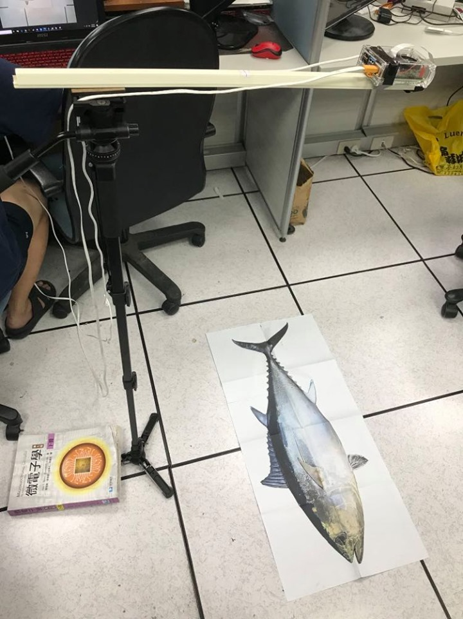
裝置

Slide 4
辨識魚種
Acanthurus_nigrofuscus
Amphiprion_clarkii
Chaetodon_lunulatus
Chaetodon_trifascialis
Chromis_chrysura
Dascyllus_reticulatus
Hemigymnus_fasciatus
Myripristis_kuntee
Neoniphon_sammara
Plectroglyphidodon_dickii

Slide 5
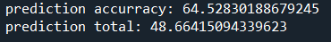
辨識方法
Yolov4-test 一張照片3分鐘
Tiny yolo-test一張照片40秒
其他神經網路架構-cnn

Slide 6
Test the raspberry pi
Install torch in raspberry pi
Install OpenCV
Test graphic user interphase : IT WORKS !

Slide 7
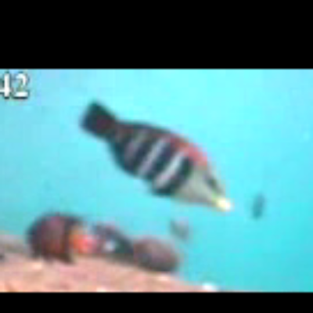
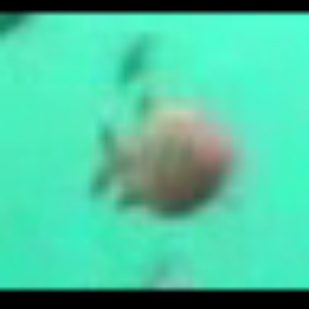
Change way to feed cnn
Don’t resize immediately
First add black borders to match the size ratio that will inter the network
Image size: 400x400
Ratio: 1:1

Slide 8
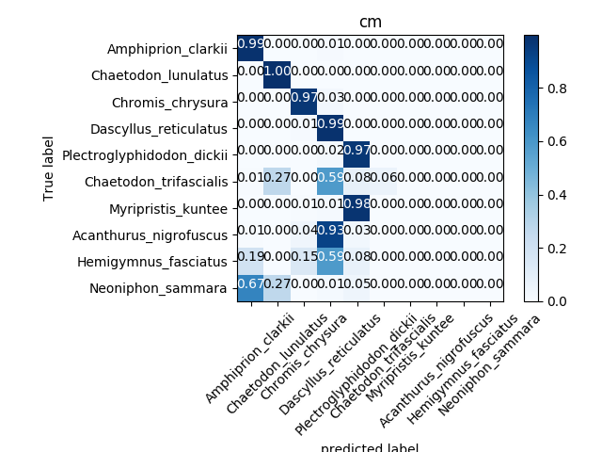
Create program to make confusion matrix
Easy way to see where the network is falling

Slide 9
Train cnn
Test multiples combinations of configurations
Full dataset per class vs only a few image per class
5 class vs 10 classes
constant learning rate vs Learning rate variable
Multiples learning rates per configuration

Slide 10
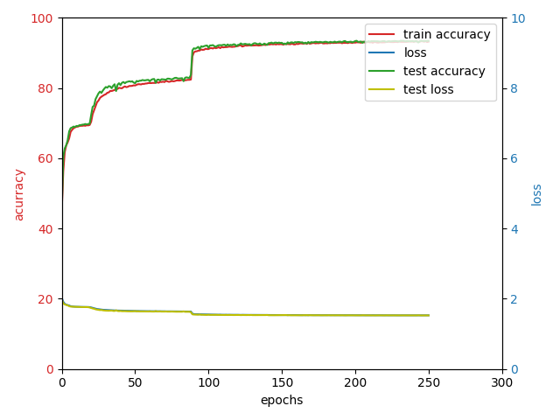
Full dataset per class vs only a few image per class
Full dataset: Very slow (>10000)
Best accuracy : 90%
But only useful for class with more photos

Slide 11
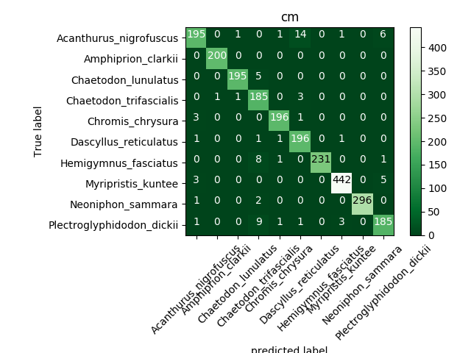
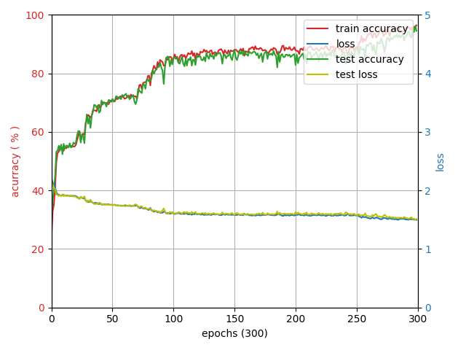
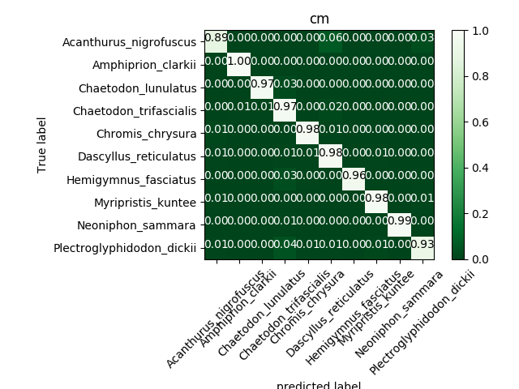
only a few image per class: fast
Best accuracy : 96% at lr= 0.0005
Better distributed
This accuracy occurs sometimes
Most of the time it stuck at 80 %
Same

Slide 12
5 class vs 10 classes (200 images per class )
5 classes :
2 different dataset: same accuracy
Around 95 %
10 classes :
Same accuracy as the separated classes

Slide 13
constant learning rate vs variable Learning rate
Variable learning rate: Not very useful
Accuracy don’t improve after changing learning rate

Slide 14
Multiples learning rates per configuration
If learning is too high : accuracy will get stuck
If learning rate is to low : accuracy will also get stuck
Only on certain range of value will get better (depend on number of classes )

Slide 15
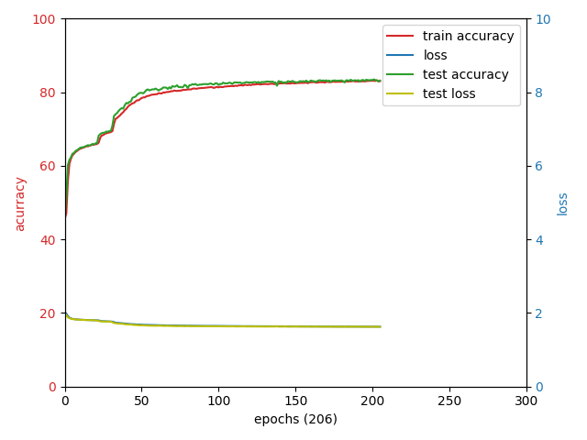
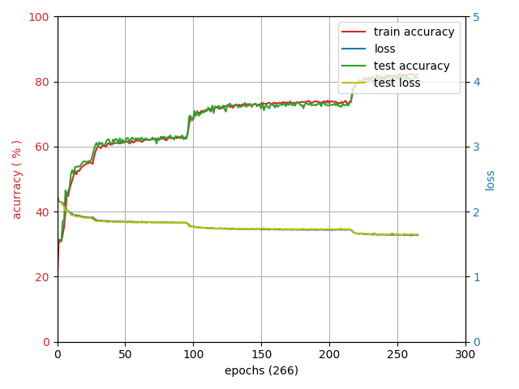
Conclusion

Slide 16
資料傳輸
讀照片
辨識/算長度
將結果寫成csv
將csv中資料從client傳至server
在server寫入csv檔案
將csv檔案匯入database
display
client.py
server.py
app.py

Slide 17
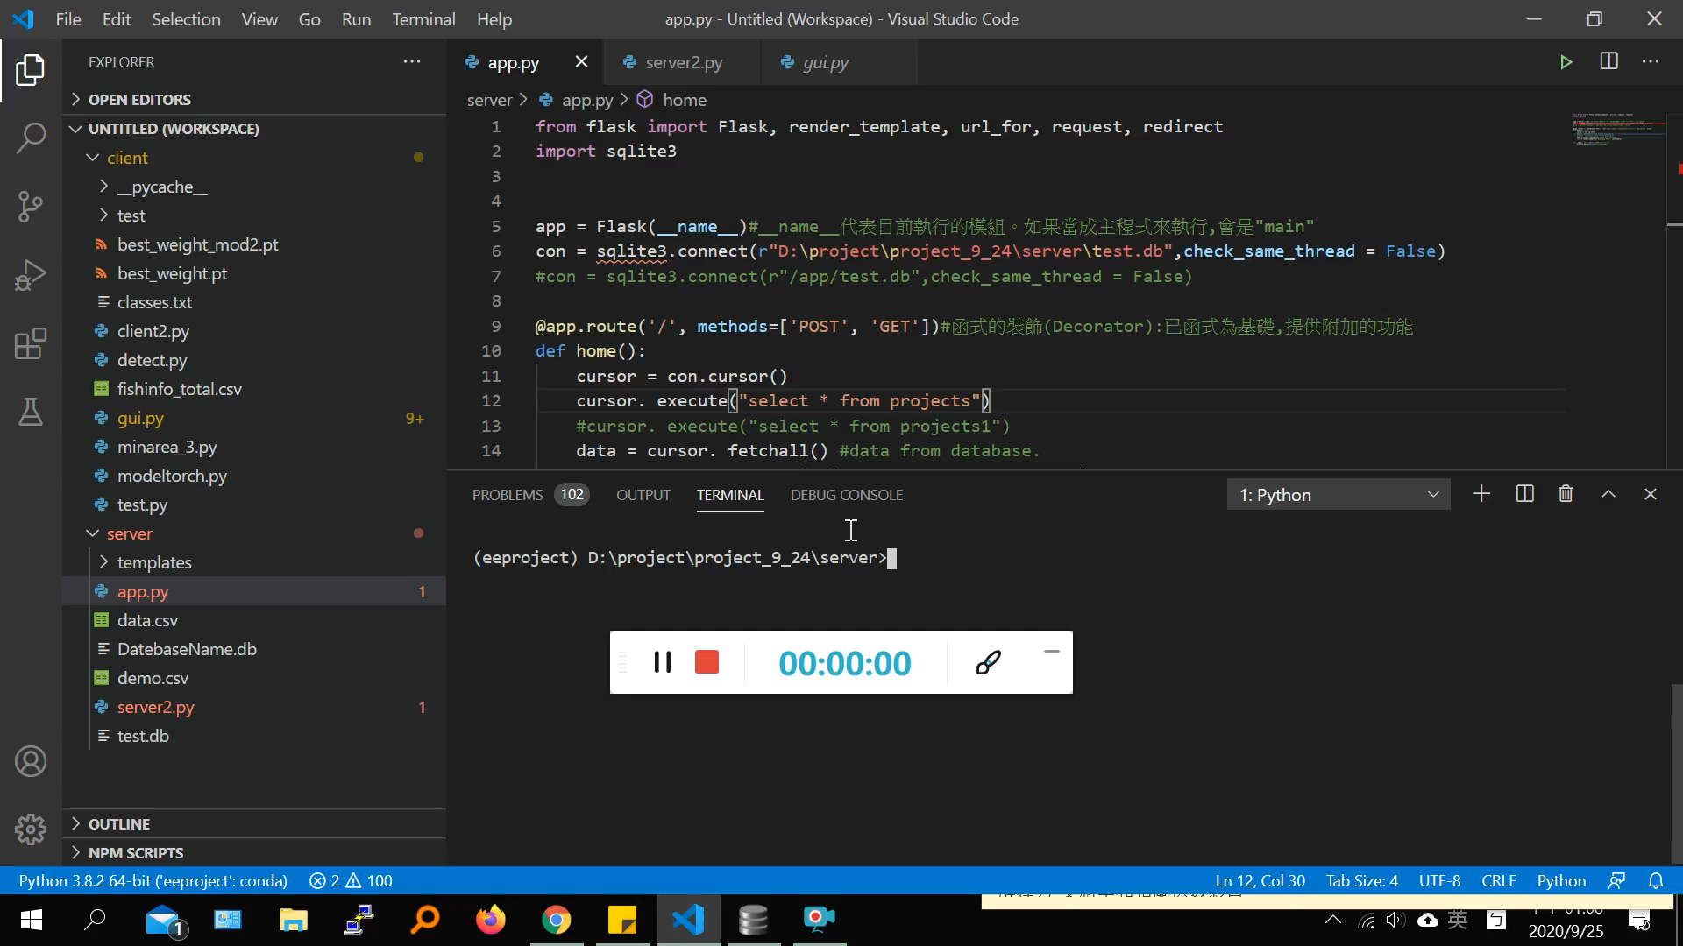

Slide 18
組員 | 王樸 | 吳承威
負責項目 | 1.網站架設 2.資料傳輸 3.yolo模型訓練 | 1.建構gui 2.cnn模型設計與訓練 3樹梅派設置
分工百分比 | 50% | 50%

Slide 19
End

